Slide 1
SNP INTERRUPT SECURITY
Ashish Kalra

Slide 2
SNP Interrupt Security Support
To protect against malicious injection attacks, SNP supports two mutually exclusive features to enforce Interrupt and Event injection security protections:
  Restricted Interrupt Injection feature
  Alternate Interrupt Injection feature

Slide 3
Why Interrupt/Exception protection ?
OS may have certain built-in assumptions about interrupt behavior based on bare-metal.
For instance, the guest OS may assume interrupts don’t arrive while EFLAGS.IF=0,
or OS may not expect a low priority interrupt when their TPR is elevated.
Malicious hypervisor can break down these assumptions and put guest drivers or guest OS kernel
into an unknown state which could be a security issue.
To address these concerns, SEV-SNP adds feature/modes that VMs can choose to enable to
support a more restrictive interface between VM and hypervisor. Restricted Injection
disables virtual interrupt queuing and partially disables interrupt injection interface,
hypervisor can only inject a single #HV exception vector to act as a doorbell.
Restricted Interrupt injection assumes that actual events are communicated in a
para-virtualized manner, such as an event queue in shared memory.

Slide 4
Restricted Interrupt Injection
Disables all hypervisor-based interrupt queueing & event injection of all
vectors except a new exception vector #HV (vector 28).
Guests running with Restricted injection are expected to communicate with
the hypervisor about events via a software-managed para-virtualization interface.
This interface uses #HV injection as a doorbell to inform the guest that new
events have been added/posted.
Virtual machines typically rely on interrupt delivery through an architectural APIC,
even for synthetic messages delivered by the host. The common #HV doorbell data
is structured to align with APIC behavior, so that existing guest interrupt
dispatch and management logic can be used.

Slide 5
HVDB
HVDB: HV Doorbell Page defined by the GHCB specifications and structured
to align with APIC behavior.
#HV doorbell page:
  PendingEvent field
  EOI Assist (NoEoiRequired)
PendingEvent is defined as follows:
  PendingEvent[15] (“NoFurtherSignal”) - indicates that the host will not signal #HV due to
  another non-maskable event until this bit is cleared by the guest.
  PendingEvent[14:10] – reserved for future use.
  PendingEvent[[9] - indicates that the host is presenting a virtual #MC to the guest.
  PendingEvent[8] - indicates that the host is presenting an NMI to the guest.
  PendingEvent[7:0] - an 8-bit interrupt vector number. When this number is non-zero, it
  indicates that the host is presenting an interrupt on the specified vector.

Slide 6
Doorbell Configuration
Doorbell page configuration through specific VMGEXIT requests communicated via the GHCB.
  GET_PREFERRED
    A guest may use this action to request the hypervisor-preferred guest physical address to use
    for the doorbell page for the vCPU issuing the request.
  SET
    A guest must use this action to set the doorbell page to be used for the vCPU issuing the
  request when the Restricted Injection feature is enabled.
  QUERY
    A guest may use this action to determine if a doorbell page has already been set for the vCPU
  issuing the request.

Slide 7
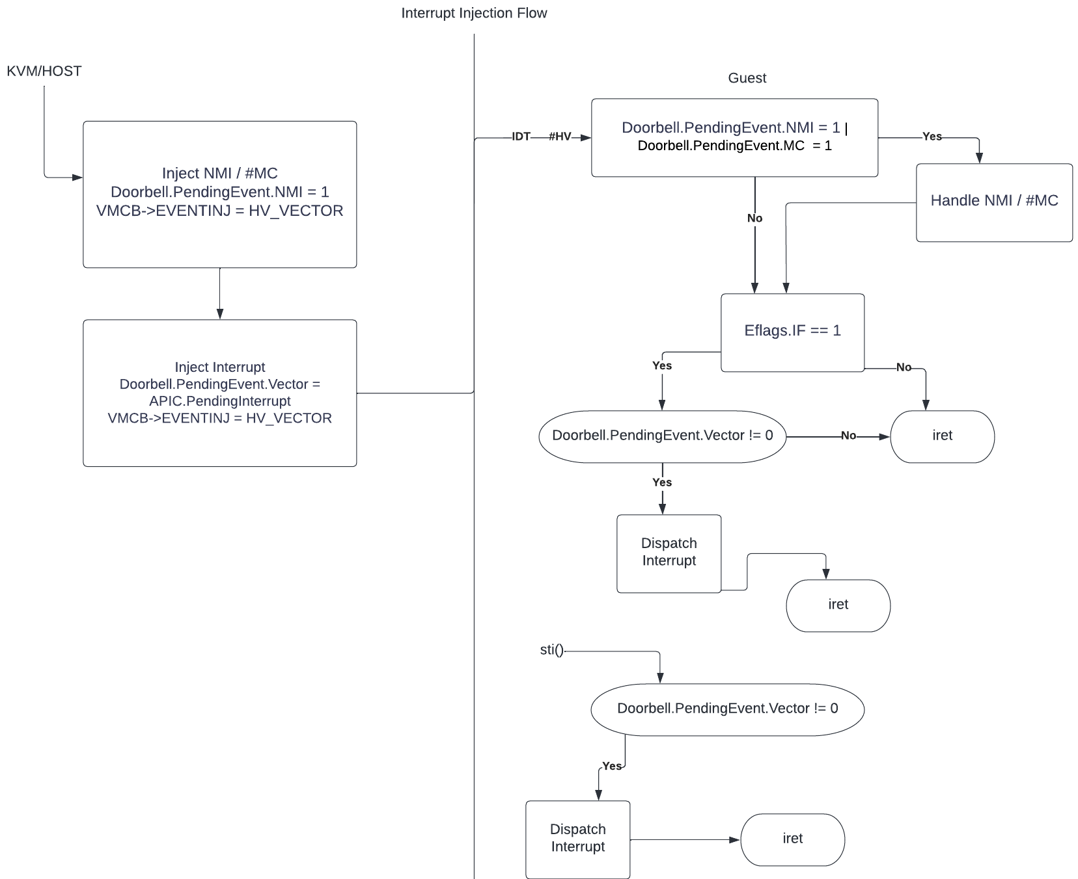

Slide 8
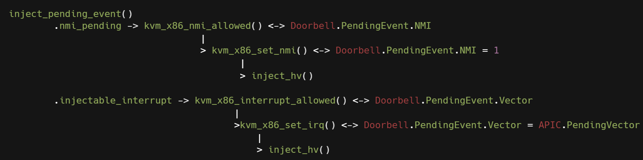
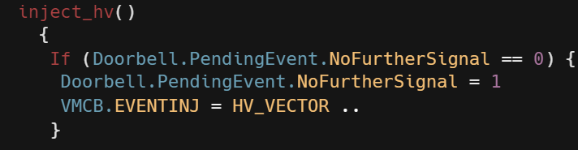
KVM/Host side interrupt injection flow:

Slide 9
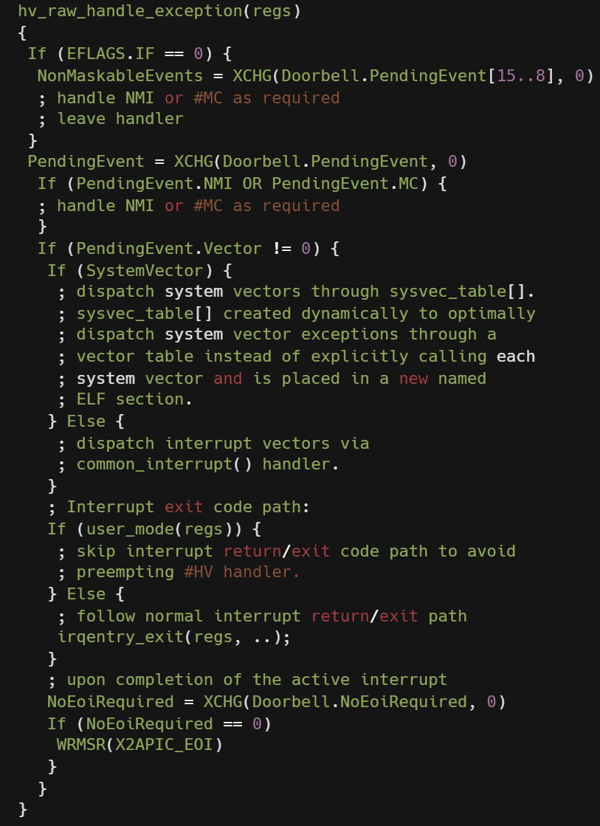
Guest #HV exception flow:
IDT -> #HV

Slide 10
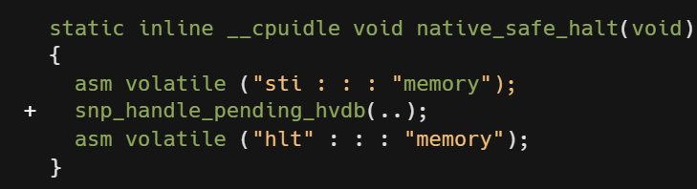
Interrupt Shadows
#HV is delivered without regard to interrupt shadows, so guests lose the
ability to control interaction between HLT and interrupts.
Ensure that guest can properly suspend when no interrupts are pending while
also ensuring that a guest will neither miss pending interrupts nor suspend
before all interrupt processing has properly completed.

Slide 11
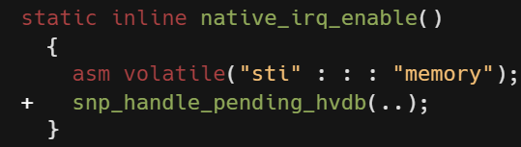
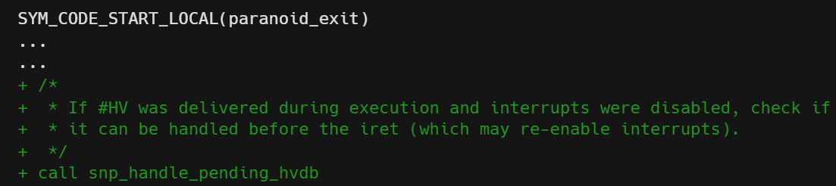
Interrupt Enable/Disable
Guest receives a #HV notification at any time, guest may choose to acknowledge
it immediately or to defer acknowledgement until EFLAGS.IF permits interrupt delivery.
Interrupt re-enabling code paths need to explicitly check for pending #HV
(as also in previous slide in native_safe_halt()) :

Slide 12
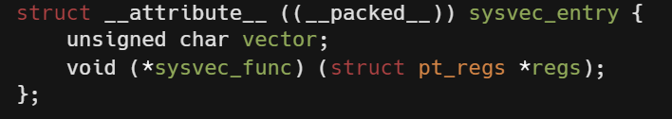
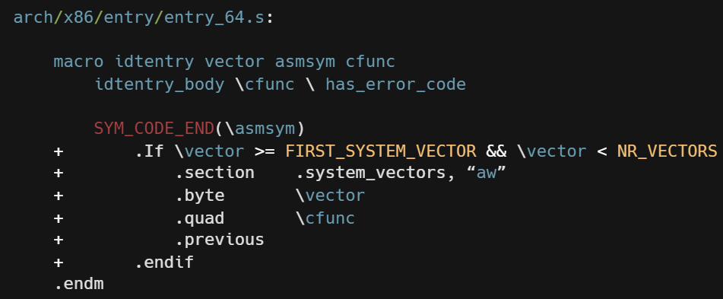
Optimized System Vector handling
Construct System Vector Table and dispatch System Vector exceptions through sysvec_table from #HV exception handler instead of explicitly calling each system vector.
System Vector Table is created dynamically and placed in a new named ELF section.

Slide 13
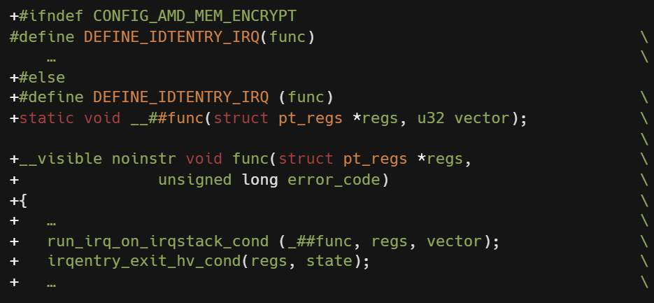
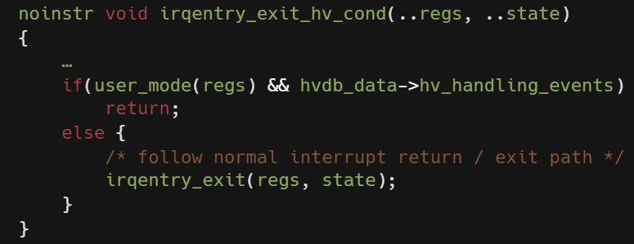
Fix Preemption in Interrupt exit code path

Slide 14
Handle Nested #HV exceptions
Support nested #HV exceptions, once IST stack is switched out.
As per GHCB specs, hypervisor will not inject another #HV if PendingEvents.NoFurtherSignal is set, and guest handler clears this only after switching out the IST stack and handling current #HV.
Window exists before IST stack is switched out, when a nested #HV can come in, check the interrupted stack to see if it is IST stack and if so, panic as this is not supported, and this nested #HV would have anyway corrupted the iretframe of the previous #HV is on the IST stack.

Slide 15
Alternate Interrupt Injection Mode
Replace all hypervisor-based interrupt queueing and
event injection with guest-controlled queueing and injection.
Feature intended to be used in a multi-VMPL architecture where
high-privilege vCPU (component like SVSM) injects events
and interrupts directly into a low-privilege (VMPL) vCPU by
writing to it's encrypted VMSA.
Event information from VMRUN is read from EventInjCtrl field
in VMSA and interrupt queuing information is read from
VintrlCtrl field in VMSA.
EventInjCtrl field in unencrypted VMCB is ignored on VMRUN.

Slide 16
Status
We have KVM/Hypervisor, Guest OVMF and Guest Kernel support implemented for SNP Restricted
Interrupt injection.
Able to boot SNP Guest using SNP Restricted Interrupt injection.
Will be posting RFC patches for SNP Restricted Interrupt injection support for Linux guest and OVMF and KVM/Hypervisor patches.

Slide 17
Copyright and disclaimer
©2022 Advanced Micro Devices, Inc. All rights reserved.
AMD, the AMD Arrow logo, [insert all other AMD trademarks used in the material IN ALPHABETICAL ORDER here per AMD's Guidelines on Using Trademark Notice and Attribution] and combinations thereof are trademarks of Advanced Micro Devices, Inc. Other product names used in this publication are for identification purposes only and may be trademarks of their respective companies.
The information presented in this document is for informational purposes only and may contain technical inaccuracies, omissions, and typographical errors. The information contained herein is subject to change and may be rendered inaccurate releases, for many reasons, including but not limited to product and roadmap changes, component and motherboard version changes, new model and/or product differences between differing manufacturers, software changes, BIOS flashes, firmware upgrades, or the like. Any computer system has risks of security vulnerabilities that cannot be completely prevented or mitigated. AMD assumes no obligation to update or otherwise correct or revise this information. However, AMD reserves the right to revise this information and to make changes from time to time to the content hereof without obligation of AMD to notify any person of such revisions or changes.
THIS INFORMATION IS PROVIDED 'AS IS." AMD MAKES NO REPRESENTATIONS OR WARRANTIES WITH RESPECT TO THE CONTENTS HEREOF AND ASSUMES NO RESPONSIBILITY FOR ANY INACCURACIES, ERRORS, OR OMISSIONS THAT MAY APPEAR IN THIS INFORMATION. AMD SPECIFICALLY DISCLAIMS ANY IMPLIED WARRANTIES OF NON-INFRINGEMENT, MERCHANTABILITY, OR FITNESS FOR ANY PARTICULAR PURPOSE. IN NO EVENT WILL AMD BE LIABLE TO ANY PERSON FOR ANY RELIANCE, DIRECT, INDIRECT, SPECIAL, OR OTHER CONSEQUENTIAL DAMAGES ARISING FROM THE USE OF ANY INFORMATION CONTAINED HEREIN, EVEN IF AMD IS EXPRESSLY ADVISED OF THE POSSIBILITY OF SUCH DAMAGES.

